Slide 1
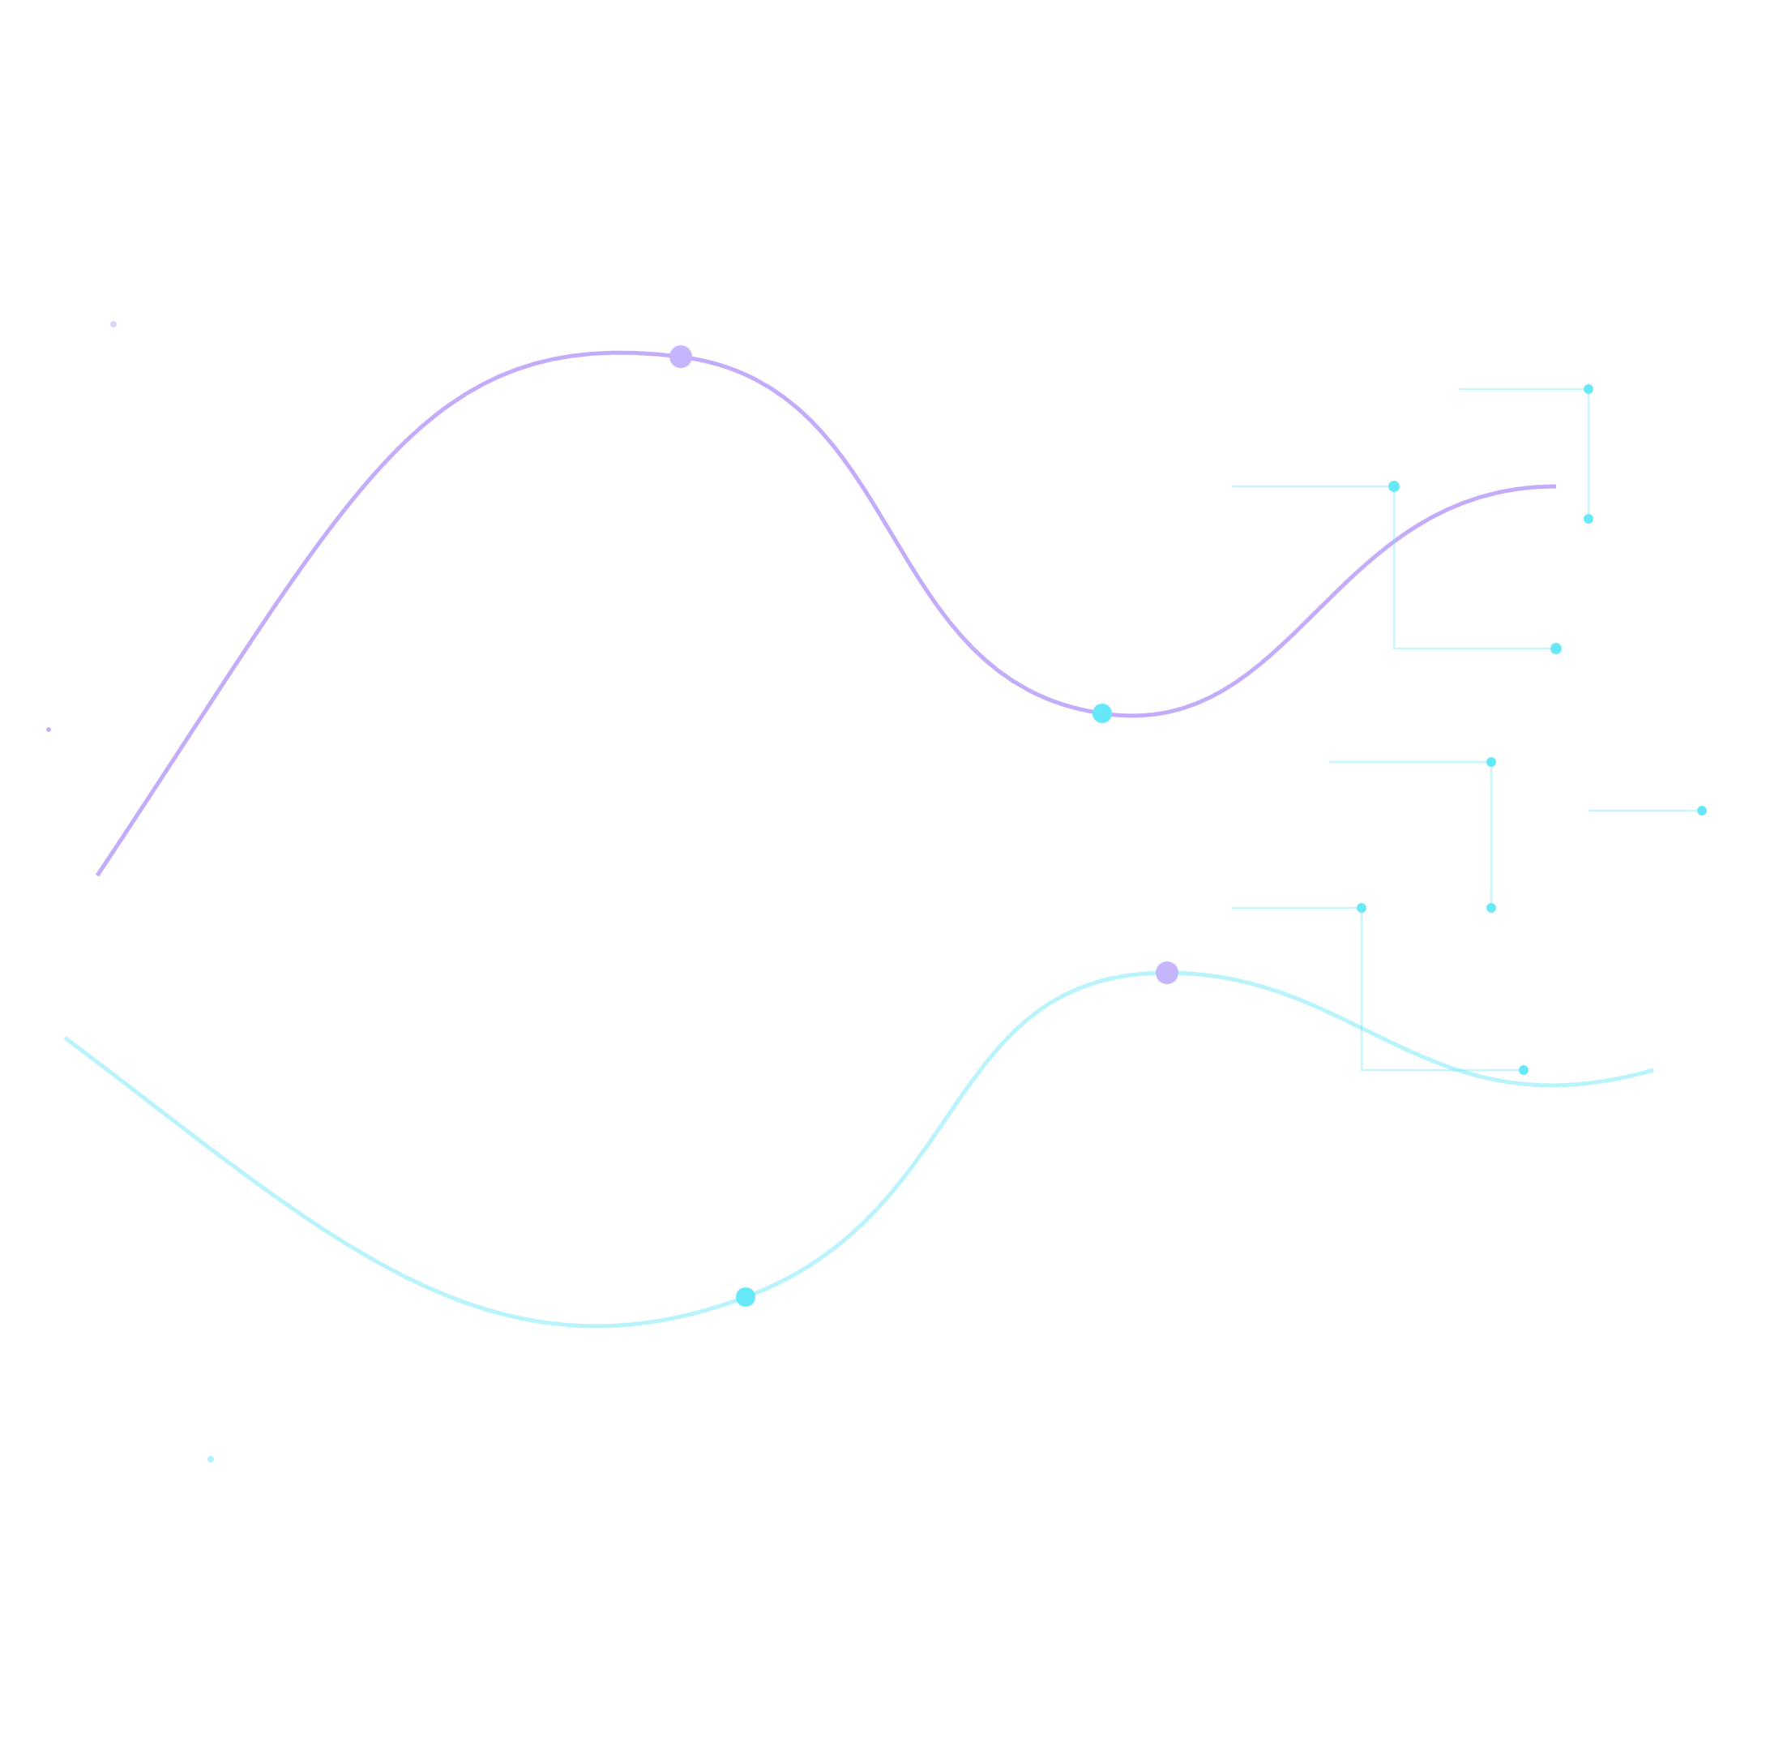
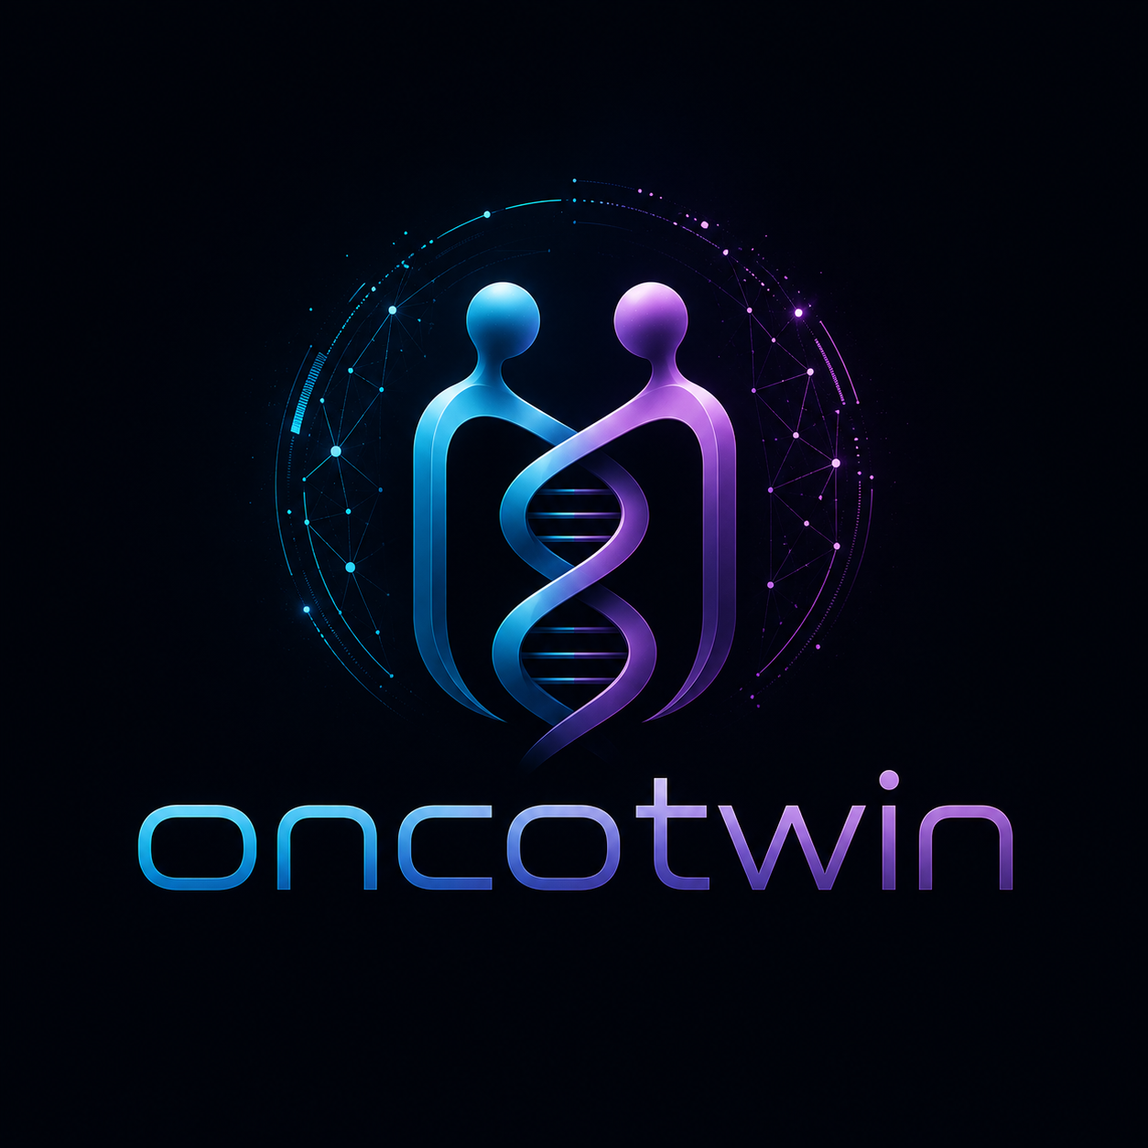
PLENARY KEYNOTE
OncoTwin
Using Digital Twins and AI to Reimagine Cancer Treatment
Robert Karienye
Notes:
Open cold, in silence — let the composition breathe for a full two seconds before speaking. Don't lead with the product, lead with the idea: biology and computation converging. Then introduce yourself.

Slide 2
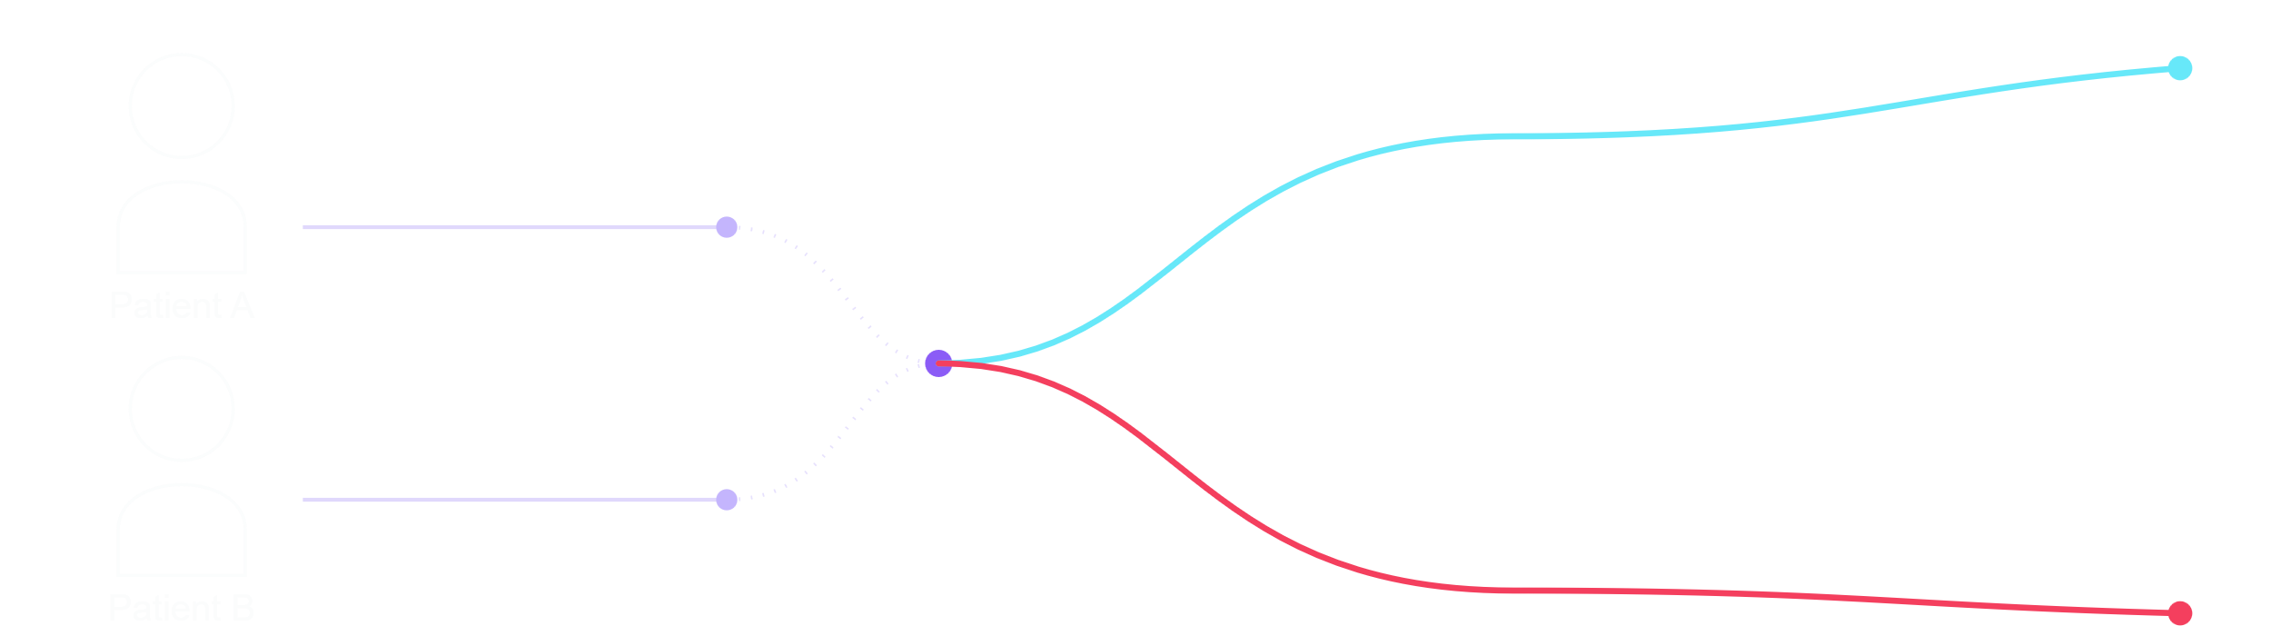
Tumor responds
Same diagnosis
Same first-line therapy
Tumor progresses
Every tumor tells a different story.
Modern oncology has transformed millions of lives. Yet patients with the same diagnosis can still respond very differently to the same treatment — not from a lack of expertise, but from biological complexity.
Source concept: WHO / IARC GLOBOCAN
Notes:
Speak before revealing anything: 'When two patients walk into a clinic with what appears to be the same diagnosis, we naturally hope they'll respond similarly to treatment. But biology rarely follows our expectations.' Then let the two paths draw and diverge in silence. Land on the headline last. Memory anchor: every patient deserves treatment informed by their own biology, not the average patient.

Slide 3
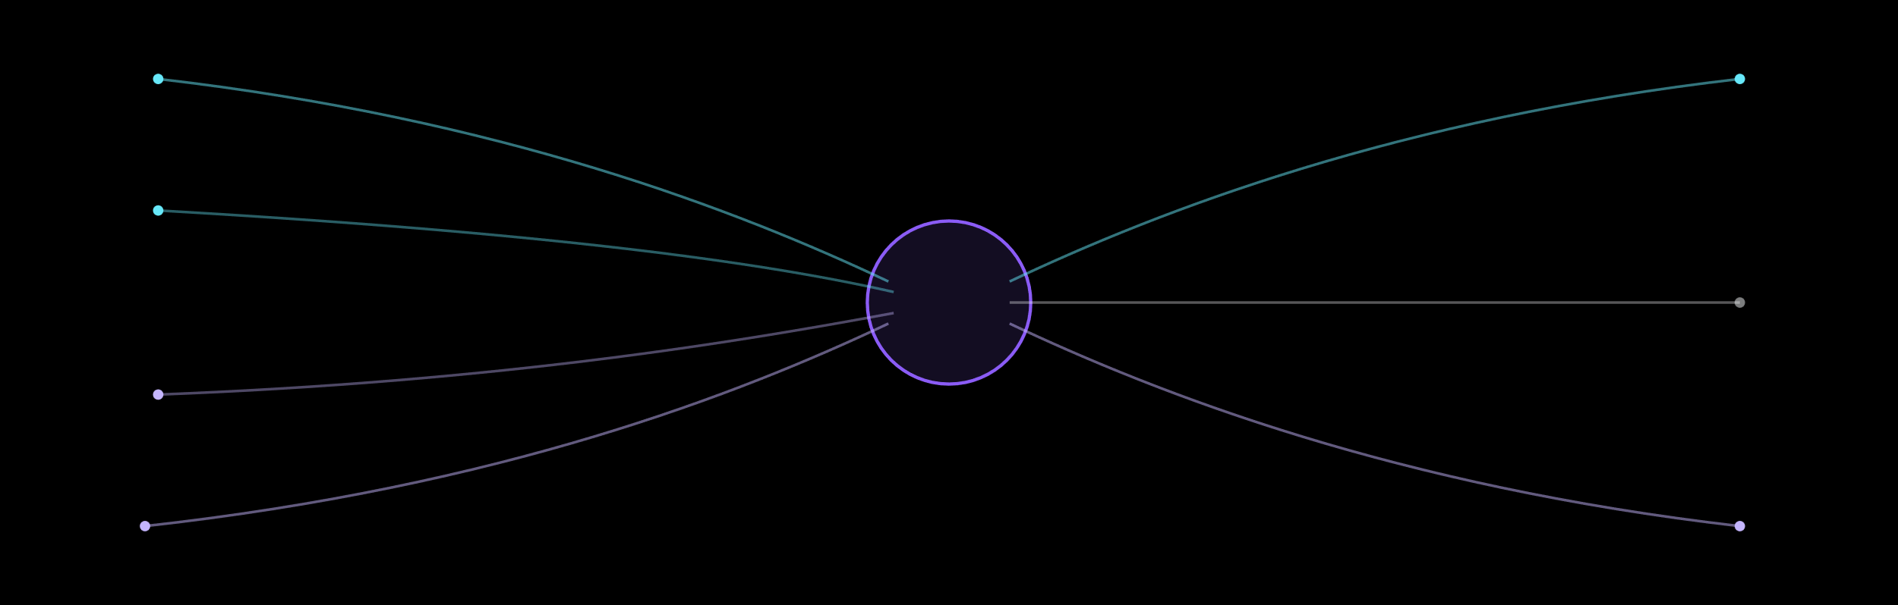
TODAY'S REALITY
CT / MRI
Genomics
Pathology
One decision
Prior response
Biomarkers
Patient history
Guidelines
Oncologists make extraordinary decisions with incomplete information.
The challenge was never a lack of expertise. It's synthesizing this much biology, for one patient, in time to act on it.
Notes:
This is about respect for clinicians, not criticism. Say: 'Oncologists today make some of the hardest decisions in medicine — with incomplete information, every time.' Let the streams converge in silence, land on the decision point, then speak the headline. Memory anchor: the challenge isn't choosing a treatment — it's choosing the right treatment for this patient.

Slide 4



A CONCEPT FROM ENGINEERING
A digital twin is a living model of a real system.
⇄
PHYSICAL SYSTEM
DIGITAL REPLICA
Real-world behavior
Simulated & predicted
A jet turbine — decades of aerospace digital twins keeping simulation in sync with reality.
A patient's scan — a live computational model, updated continuously, tested before reality is.
Aerospace and manufacturing have used this idea for decades. Medicine hasn't — yet.
Notes:
Introduce the concept before the product. Digital twins are established engineering practice — jet engines, wind turbines — a live computational model kept in sync with reality. The mirror-axis visual is the metaphor: hold on it a beat before speaking.

Slide 5
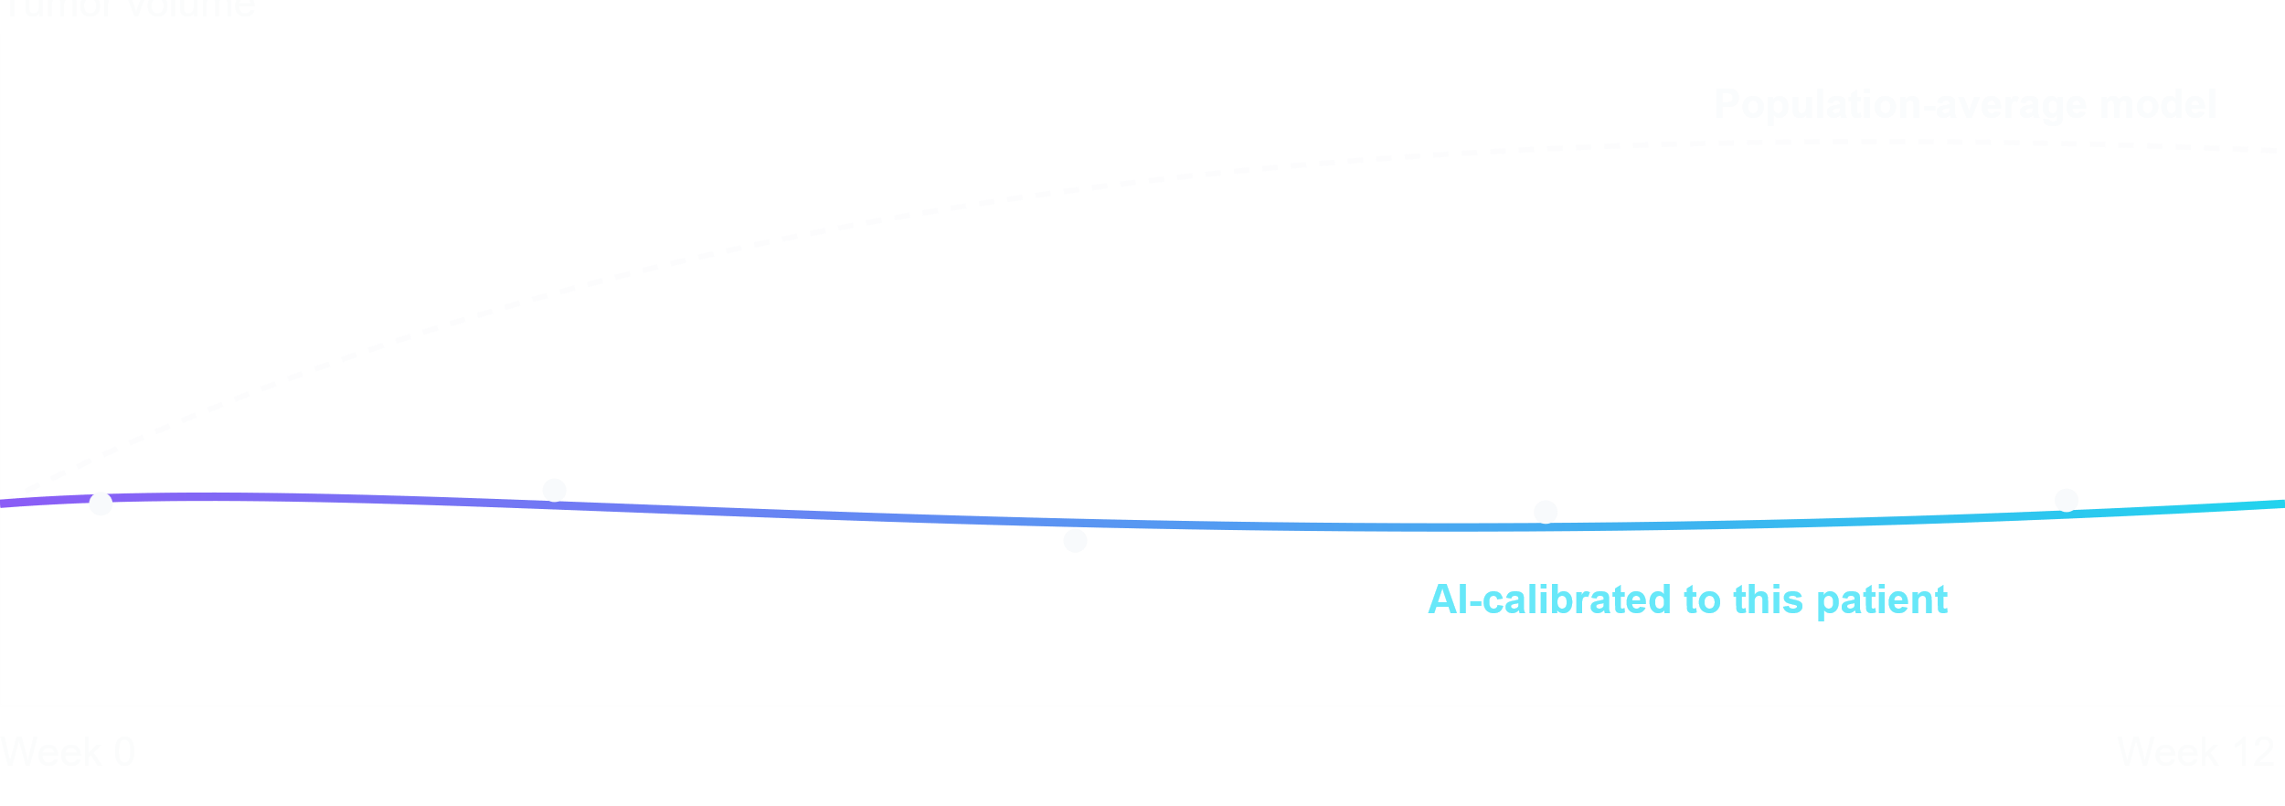
THE MISSING PIECE
AI doesn't replace the biology. It calibrates it.
Same equation. Same biology. AI fits the model's parameters to this patient's own scans — not the population's.
Notes:
Key credibility slide, said plainly: AI is not replacing the biological model — it makes it personal. Walk the chart left to right: the dashed line is a population-average prediction drifting away from this patient's actual scans; the solid line is the same mechanistic equation, re-fit by AI to this patient's own data points. That gap is the whole idea.

Slide 6
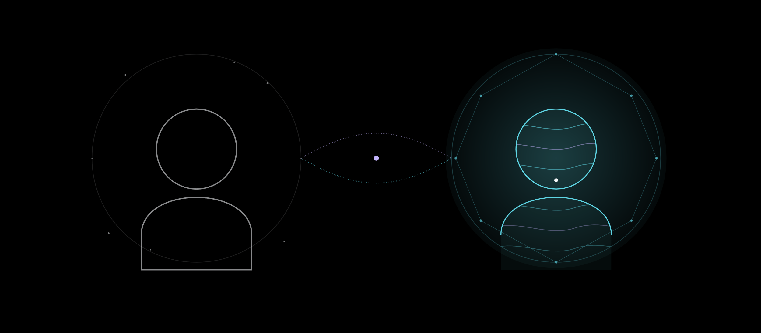
The patient
The living twin
Meet OncoTwin.
A living computational model of an individual patient — built to simulate treatment before treatment begins.
Notes:
This is the emotional climax of the first half. Say nothing while the twin forms beside the patient silhouette — let it breathe for a full three seconds. Then, quietly: 'Meet OncoTwin.' Pause. Then the second line. Do not explain architecture here — that comes next. This slide's only job is to be remembered.

Slide 7
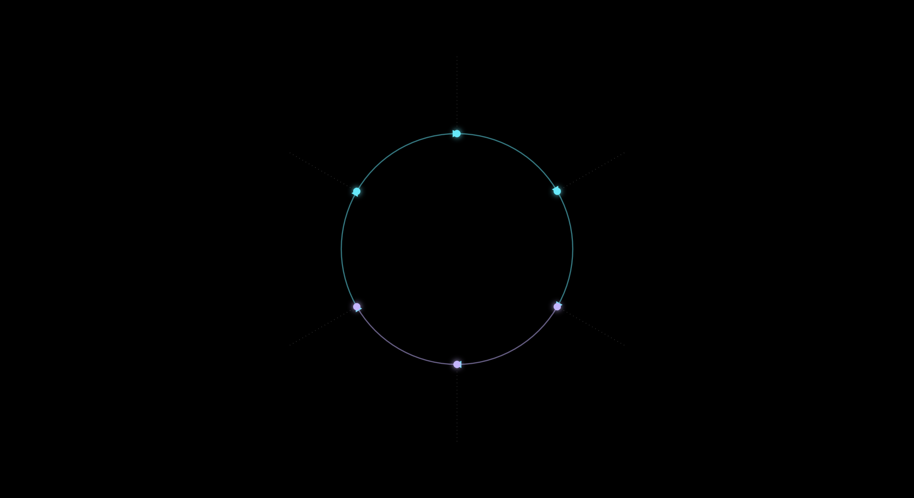
HOW IT FITS TOGETHER
A continuous loop, not a one-shot prediction
01
Patient Data
↺
02
Outcomes feed back in
Mechanistic Core
THE
Patient Twin
05
03
Clinician Dashboard
AI Calibration
04
Simulation Engine
Notes:
Zoom out to the whole loop before diving into detail. Walk around the orbit clockwise, then land on the feedback arrow — this is not a one-shot prediction, the twin keeps updating as new patient data arrives.

Slide 8

FROM DIAGNOSIS TO DECISION
The patient journey, mapped
Diagnosis
Twin initialized
Clinician decides
Tumor identified & staged
Model calibrated to this patient
Treatment selected & started
Twin updates
Data intake
Options simulated
Response data refines the model — the loop continues
Imaging, labs, genomics gathered
Regimens compared in silico
Notes:
Make this concrete: walk through one patient's path start to finish, following the route left to right like a map. First three stops (cyan) are diagnostic; last three (purple) are decision & follow-up. Let each waypoint land before moving to the next.

Slide 9
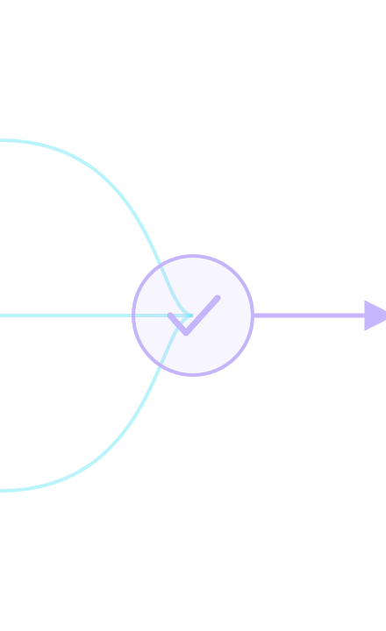
IN THE CLINIC
The clinician always makes the final call.
ONCOTWIN SUGGESTS
REVIEWED & DECIDED BY THE ONCOLOGIST
Simulates candidate regimens
The oncologist decides & owns the outcome.
Flags risk & uncertainty
Compares options side by side
OncoTwin informs. It never prescribes.
Notes:
This is the trust slide. Say explicitly, out loud: the clinician always makes the final call. The visual weight is deliberately unequal — OncoTwin's panel is small and quiet, the clinician's is dominant.

Slide 10

UNDER THE HOOD
A mechanistic core, calibrated by AI
EXAMPLE — TUMOR GROWTH
Data ingestion & preprocessing
Mechanistic core — ODE/PDE tumor–therapy models
dV
=
λV
ln
(
K
)
dt
V
AI calibration & uncertainty quantification
The tumour is described using a mechanistic growth equation. Patient-specific parameters such as growth rate (λ) and carrying capacity (K) are inferred from longitudinal imaging and clinical measurements. AI assists with parameter estimation and quantifies uncertainty, enabling simulations tailored to the individual patient.
Simulation & scenario engine
Clinical interface & API
Notes:
For the technical portion of the audience. Show one concrete example model (Gompertz growth) so it's clear this is real applied mathematics. Explain: lambda and K are patient-specific and unknown at diagnosis; AI estimates them from that patient's own time-series data, with uncertainty.

Slide 11

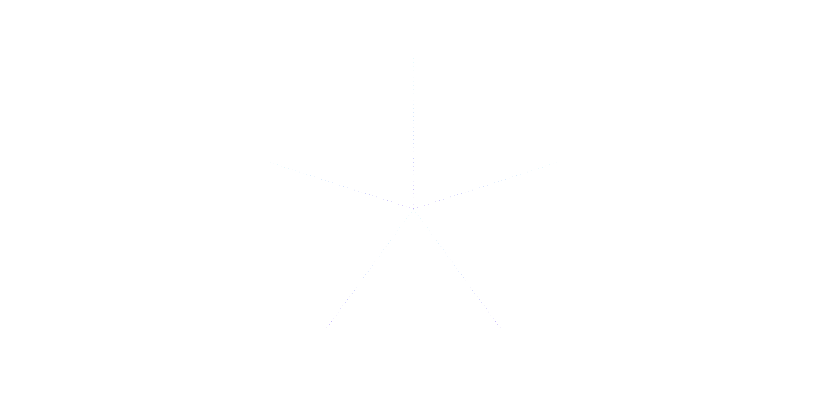




WHAT FEEDS THE TWIN
Data sources
Imaging
MRI · CT · PET
Per treatment cycle
Longitudinal outcomes
Genomics & pathology
Response over the course of care
Tumor biology markers
Patient
Ongoing
Twin
At diagnosis
EHR & history
Labs & biomarkers
Treatment & medical record
Blood panels over time
Baseline
Continuous
Interoperable with standard clinical data formats (DICOM, HL7 FHIR).
Notes:
Emphasize breadth and that this is real longitudinal clinical data, not a snapshot — the twin gets more accurate over the course of treatment as more data arrives. Walk the spokes clockwise.

Slide 12
01
Data privacy & governance
Rigorous protection and clear consent.
02
Rigorous clinical validation
Nothing reaches practice without prospective evidence.
BEING HONEST
The hard parts we won't skip.
03
Bias & generalizability
Must work across populations, not just training data.
04
Explainability & trust
Clinicians must see why the twin says what it says.
05
Equitable access
Reaching beyond well-resourced hospitals.
No model reaches patients without passing through all five.
Notes:
Credibility slide — be candid, this is early research. Don't oversell. Naming these risks directly builds trust with clinicians and policymakers far more than glossing over them. Read down the marginalia numbers slowly.

Slide 13

WHERE WE ARE
Roadmap
PHASE 2
PHASE 4
Retrospective pilots
Regulatory path & scale
Testing against historical clinical data
Toward broader clinical deployment
PHASE 1 · NOW
PHASE 3
Research & model validation
Prospective studies
With hospital & clinical partners
Building & testing the mechanistic-AI core
Notes:
Be honest: this is Phase 1, research and validation. Set expectations correctly — this is a multi-year path. Phase 1 should glow; the rest sit quieter ahead on the line.

Slide 14
BUILD THIS WITH US
OncoTwin is early — and it needs partners.
Clinical & data partners
Oncology teams to co-design and test against real cases
Research collaborators
In applied math, AI, and computational oncology
Funding & investment
To move from prototype to validated pilots
Early pilot sites
Hospitals ready to test decision support in the clinic
Notes:
This is the ask. Be direct about who you need: clinical/data partners, math/AI researchers, funders, and pilot hospital sites. This should feel like an invitation to a scientific effort, not a pitch. Let the biggest line land last.

Slide 15
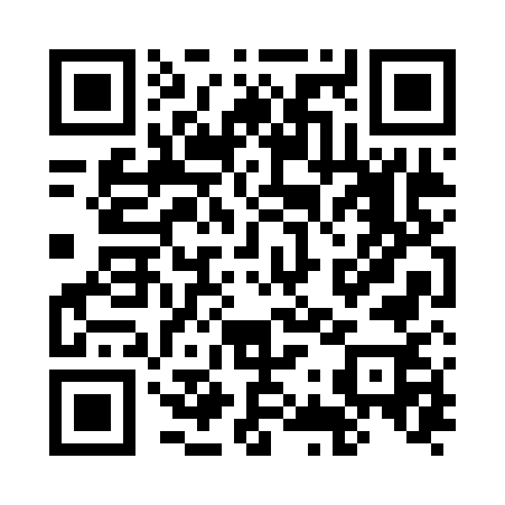
Thank you
Let's build the future of precision oncology together.
oncotwin.africa
hello@oncotwin.africa
Robert Karienye · karienye@oncotwin.africa
Notes:
Close warmly, mirroring the opening. Reiterate the core idea in one sentence and invite people to talk afterward. Contact details are placeholder — swap in real ones before presenting.

